Slide 1
A Yang Data Model for ACTN VN Operation draft-ietf-teas-actn-vn-yang-02
Young Lee, Dhruv Dhody, Daniele Ceccarelli
Igor Bryskin, Bin Yeong Yoon, Qin Wu, Peter Park

Slide 2
ACTN Yang Model Map
L3SM
Augmented with underlying TE
L2SM
Augmented with underlying TE
L1CSM
Augmented with underlying TE
Service Models
TE Topology
TE Tunnel
VN
TE Models

Slide 3
ACTN VN Yang
Yang model for Virtual Network Service (VNS) operations
From the point of view of Customer
An abstraction over the TE-Topo and TE-Tunnel
These models are from the point of view of Network
Some similarity, but still different!
VN is a higher level of abstraction than topology!
VN depends on topology!

Slide 4
Relationship
ACTN VN
Single node in TE Topology
Native TE Topology
abstract topology
Customer
Network
In case of VN Type 2 operations, customer could access!

Slide 5
Node
connectivity-matrices
underlay
primary-path
path-constraints
Optimizations
computed-path-properties
connectivity-matrix [id]
From
underlay
Primary-path
path-constraints
Optimizations
To
tunnel-termination-points
tunnel
ACTN VN
AP
VNAP
VN
VN-Member
From
To
global
Per entry

Slide 6
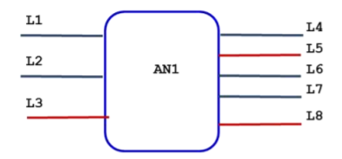

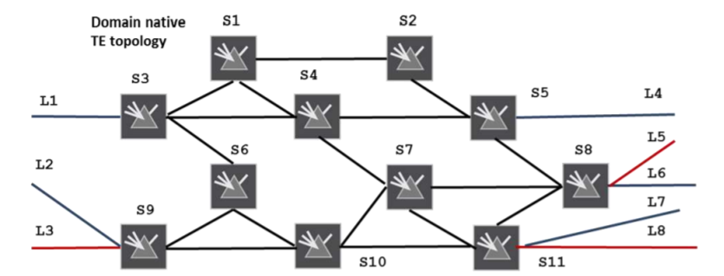
Overview
Abstract Topology with a
Single Node
ACTN VN Yang Model
AP/VNAP
VN
VN-Member
Connectivity
Matrix
For both VN Type 1 or Type 2 VN Yang model rely on a single node in the abstract TE Topology
The abstract node has
connectivity-matrices
connectivity-matrix [id]
The attributes directly under container connectivity-matrices are the default attributes for all connectivity-matrix entries when the per entry corresponding attribute is not specified. When a per entry attribute is specified, it overrides the corresponding attribute directly under the container connectivity-matrices.
Underlay

Slide 7
VN Type 1
VN is seen as edge to edge links (VN-members) setup as tunnels across underlying networks!
Abstract Topology with a
Single Node
VN 1
VN-Member 1 L1-L4
VN-Member 2 L1-L7
VN-Member 3 L2-L4
VN-Member 4 L3-L8
This VN has following properties
Bandwidth 500
Optimize by delay
connectivity-matrices
Attributes
These properties
are set in TE Topo
14: L1-L4 | 17: L1-L7
24: L2-L4 | 38: L3-L8
Connectivity
Matrix

Slide 8
VN Type 2
Abstract Topology with a
Single Node
VN is seems as a topology of virtual nodes and links
To ease mapping between VN Yang Model and TE models, an abstract single node topology is created with VN topology as the underlay!
The same mapping as VN Type 1 is reused.
VN 2
VN-Member 1: L1-L8 via S3, S67110, S11
Set via the underlay path in connectivity-matrix[id]
Underlay
VN Topology
S3
S124
S5
S8
S9
S67110
S11
Underlay

Slide 9
ACTN Info Model [RFC 8454]
VN Action primitives on CMI -
VN Instantiate
VN Modify
VN Delete
VN Update
VN Path Compute
VN Query
Maps to actions on ACTN VN Yang model easily
But, with dependency on the TE topology model when it comes to details such as constraints, actual path etc

Slide 10
ACTN VN Operations
VN could be explicitly created via this yang model
VN could also be auto-created based on the service model
With a service mapping to the VN
Via ACTN VN abstraction, customer could learn how the network fulfills the service!
Further allow some new interesting services!
Multi-Source / Multi-Destination
VN Compute

Slide 11
Status
Adopted as WG draft after IETF 101.
Relationship between other models clarified
Suggest further improvements
Security & IANA considerations updated

Slide 12
BACKUP!

Slide 13
How: Reference to TE Topology Yang Model
Access | AP/ VNAP -> LTP Ltp of type te-types:te-tp-id
Customer’s Virtual Network | VN -> Abstract Node vn-topology-id of type te-types:te-topology-id abstract-node -> /nw:networks/network/node/tet:te-node-id (reference)
Customer Site to Site connection | VN-Member -> Entry in the connectivity matrix of the abstract node connectivity-matrix-id -> /nw:networks/network/node/tet:te/te- node-attributes/connectivity-matrices/connectivity-matrix/id (reference)
All parameters which are can be set as global attributes to VN are set in the connectivity-matrices (such as bandwidth) and an attribute for a particular VN-member is set in the connectivity-matrix [id] (such as explicit path)!
Duplicate parameters in ACTN VN Yang model are removed!

